Slide 1

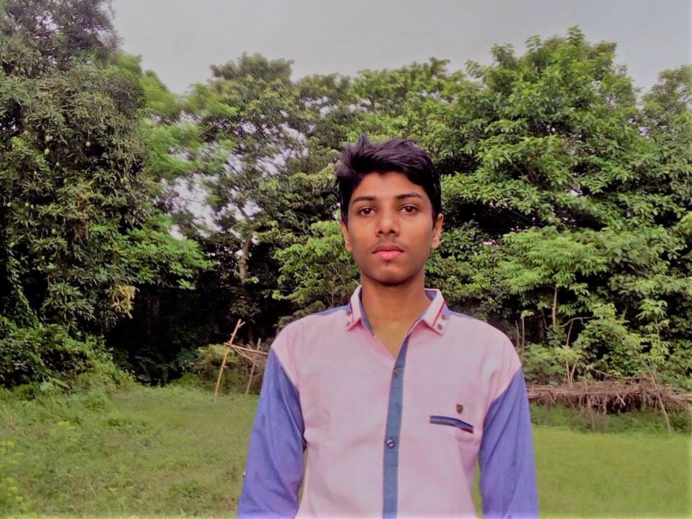

WELCOME TO OUR PRESENTATION
MD.FARUQE HASAN
163432560
ZULKAR-NINE
163432601
SAJEDUL ISLAM
163432559

Slide 2
PROJECT NAME
E-AGRECULTUR

Slide 3
INTRODUCTION
Bangladesh is a agriculture dependent country . Agriculture is the largest employment in Bangladesh.
Online agriculture is becoming a suitable way to make all your purchases crops, whether you’re at home or anywhere.
Taking to online agriculture to search Crops or service, compare prices & to shop by bidding.

Slide 4
Abstract
The agricultural information system provides is users to get online information about , fruits, vegetables statistical details and new tendencies.
the main features of the information system includes information retrieval facilities for Farmers are Import product for Bidding from anywhere in the form of obtaining statistical information about fruits, vegetables, statistical information about exports etc. Customer Can buy Crops with bidding.

Slide 5
BACKGROUND STUDY
In Bangladesh, the agricultural sector is one of the main contributors to the national GDP.
An amount of 15.95 %(including fisheries) of the total GDP in the fiscal year 2014-2015 of our country has come from the agricultural sector (BER, 2015).
But, most of the farmers of Bangladesh are still in lack of modern agricultural knowledge and information. People having internet facilities have better access to information, which help them to acquire better position in economic activities.

Slide 6

FEATURES OF E-AGRICULTURAL
Register/login
Permission(Admin)
Crops Import/Manage
Crops category
Import/Export
Search System
Special Offers
Database Design
Update & Delete crops
Crop Bidding
Comment box

Slide 7
GANTT CHART

Slide 8
SOFTWARE
Sublime text
Xampp
MySQL
laravel

Slide 9
DATA FLOW DIAGRAM
F_ info
Admin
F - Data
Registration
User data
User
User info
F_data
Farmer
User data
Login
Data Login
User data
F-Data
Import crop
Update &delete crop
Biding

Slide 10
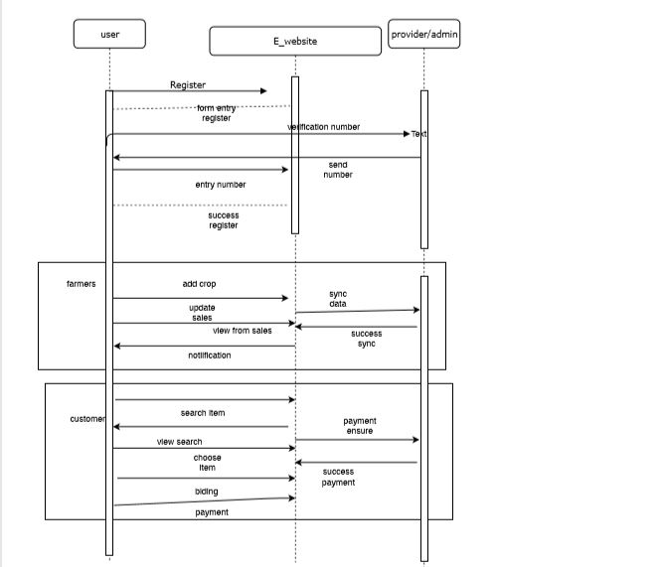
UML DIAGRAM

Slide 11
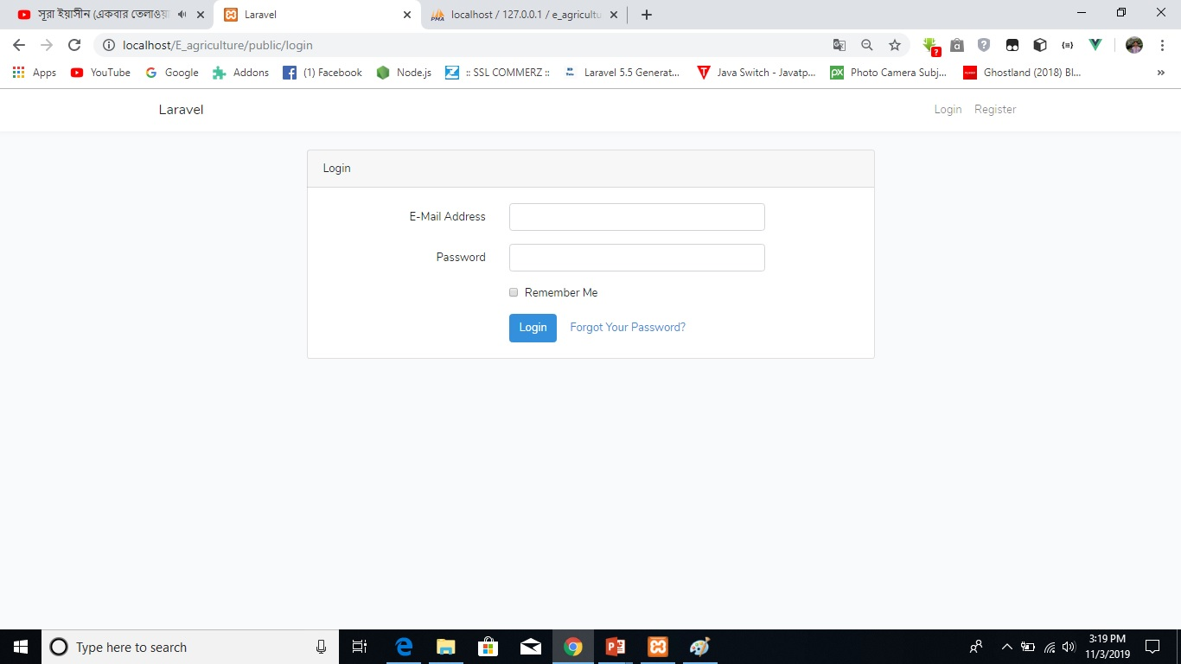
Admin login

Slide 12
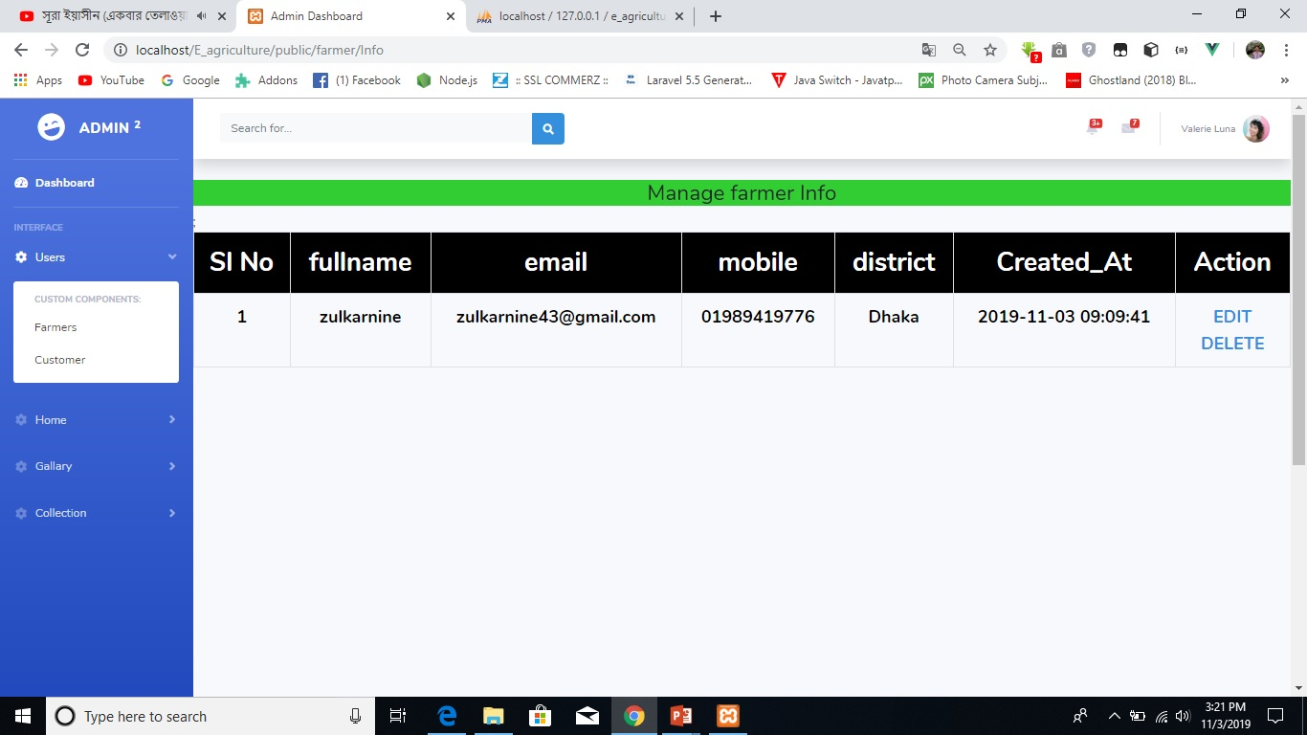
Admin panel

Slide 13
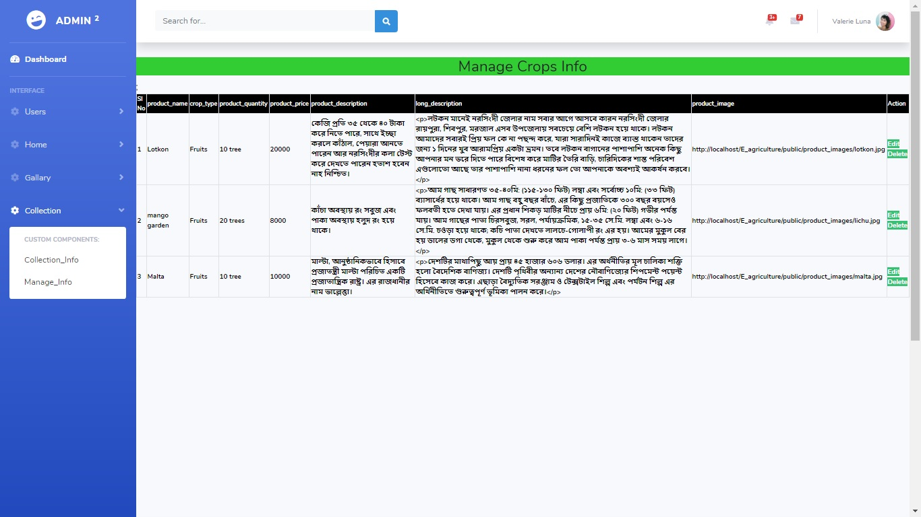
Admin panel

Slide 14
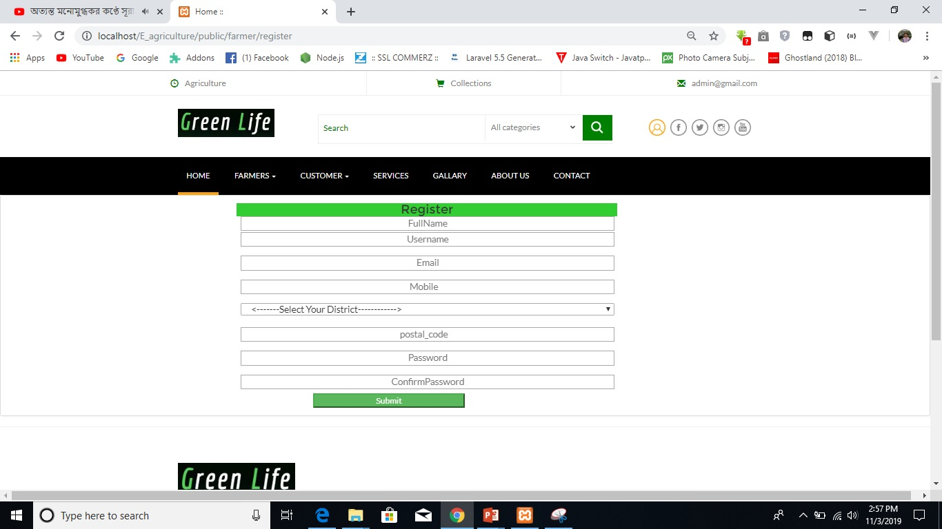
Customer/Farmer register

Slide 15
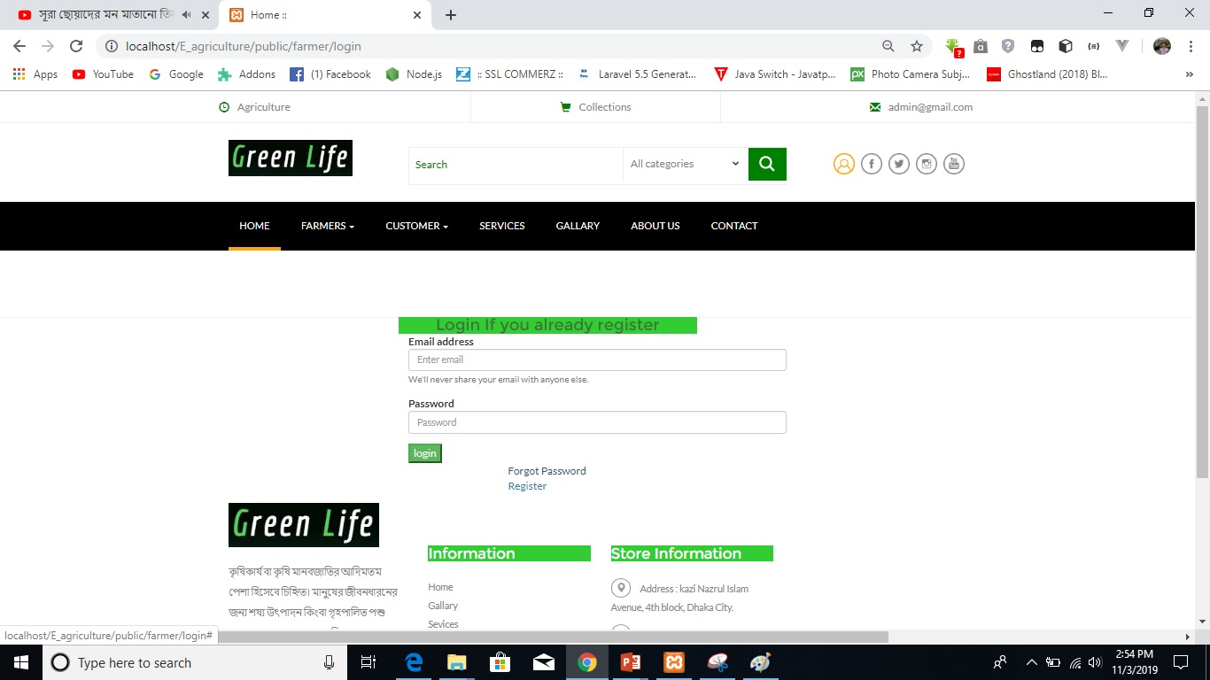
Customer/Farmer login

Slide 16
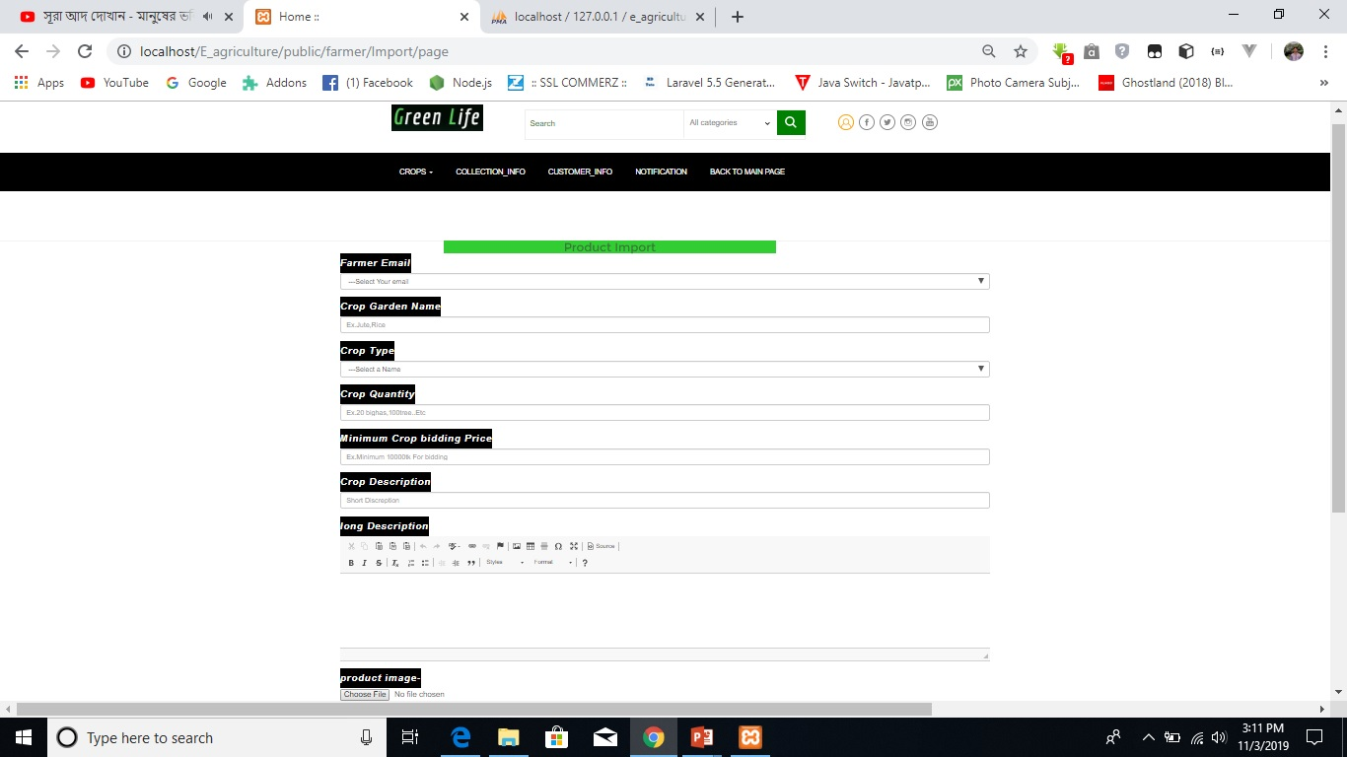
Farmer Import Crop

Slide 17
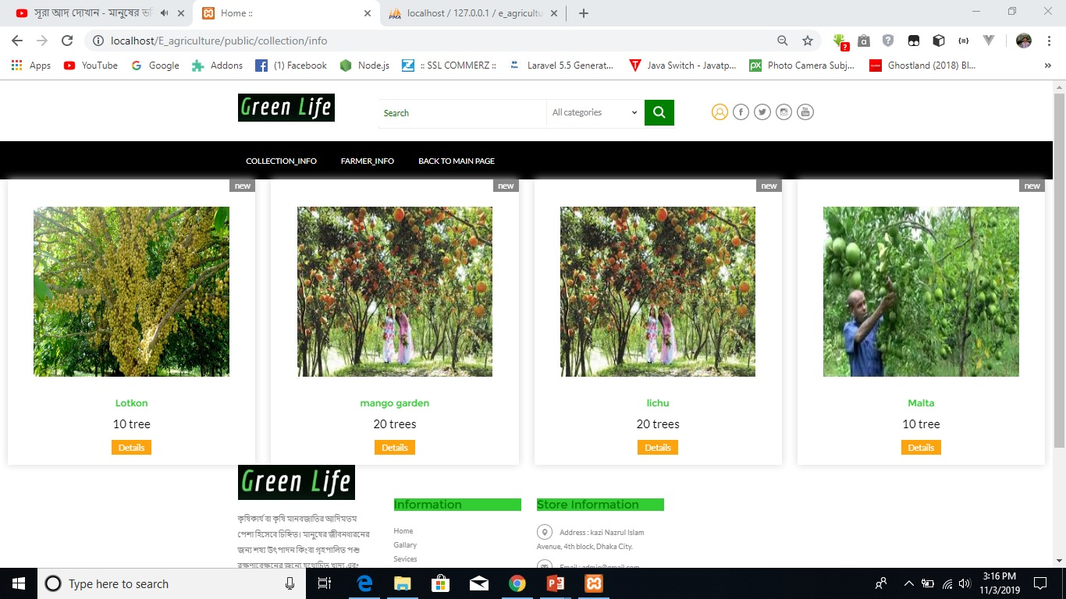
Crop Collection

Slide 18
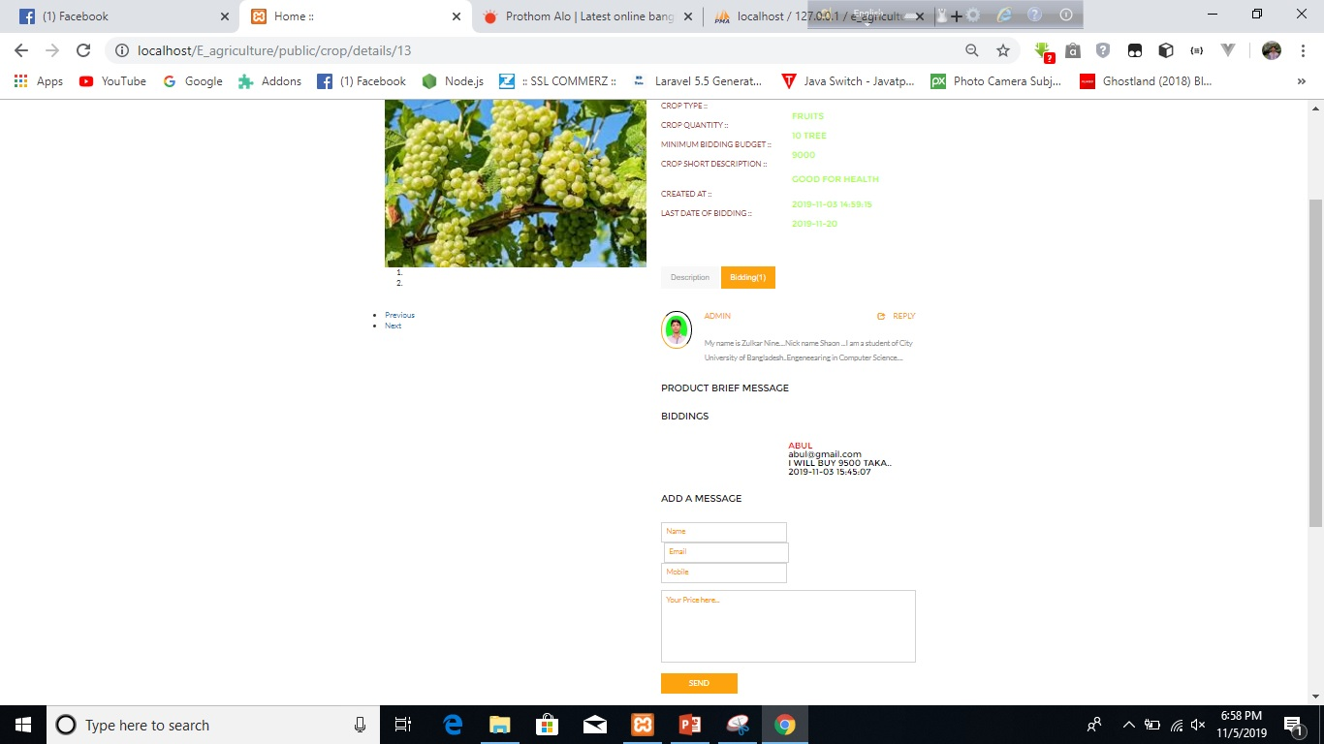
Bidding

Slide 19
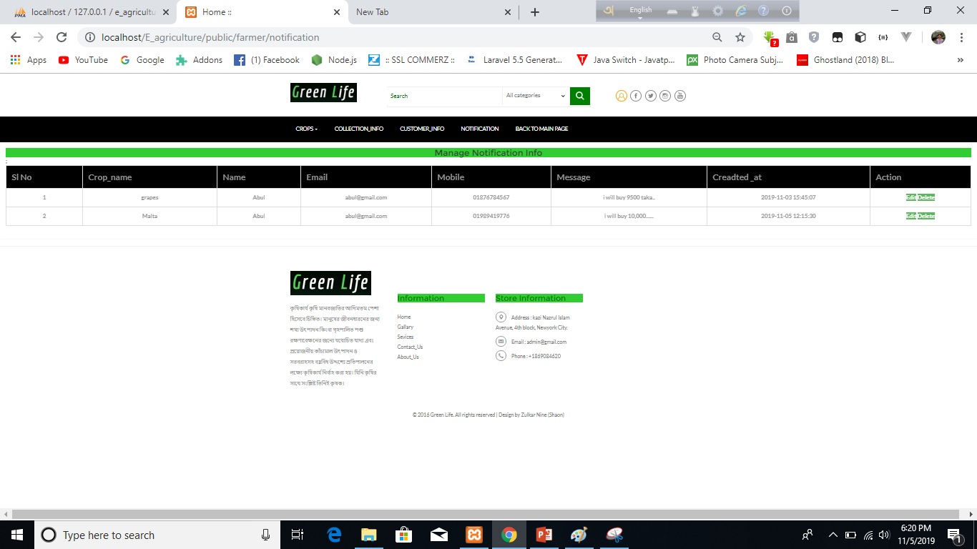
Notification

Slide 20
Future Scope
We will add more feature in day by day .
We will make also android app for this E- Agriculture project.

Slide 21
Thank You

